Slide 1
Laptop Recommendation Expert System
GROUP 8

Slide 2
Overview
Introduction
Knowledge Sources & Acquisition
Knowledge Design & Engineering
Implementation

Slide 3
Motivation for the Project.
Many fooled by shopkeeper’s words or exciting offers from online sites.
With this expert system ,one wouldn’t have to take a step out of his door for market.

Slide 4
Introduction
Laptops have become indispensable part of every people these days.
With a large number of options and the associated technical jargon can be overwhelming for a layman .
A Laptop recommendation expert system aims to suggest the best laptop available according to the requirements of the user and satisfying the budget constraints.

Slide 5
What is an Expert System ?
Computer system that emulates the decision making ability of a human expert
Solves complex problems
Uses reasoning about the knowledge
Knowledge represented in form of IF-THEN rules
Relates facts to actions

Slide 6
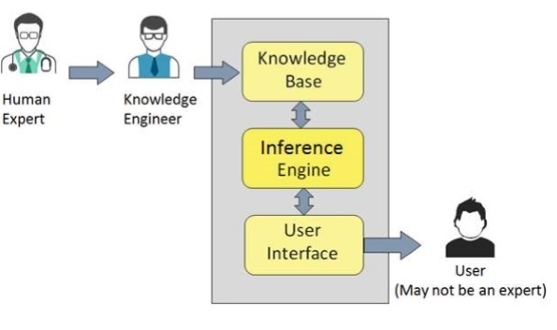
Structure of An expert system

Slide 7
Knowledge Source and Acquisition
Knowledge source is taken from amazon.in as a reference.
We took laptops from different companies comprising of different models.
PHP Adminer and MySQL for collaborative collection of data.
Attributes collected for each laptop:
Processor
Graphic card
Screen size
Hard disk
Clock frequency
Brand, etc.

Slide 8
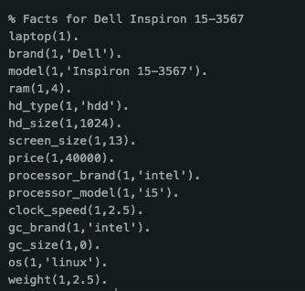

Slide 9
Knowledge Design and Engineering
The laptops are first classified into four main categories - Gaming, Clerical, Development, Home based on hardware specifications and operating system present.
The resultant list obtained is checked for price constraints.
Laptops having price greater than the budget provided by the user are removed from the list.
the list is sorted using a custom made comparator function such that the best laptop is at the head of the list, which is then recommended to the user.

Slide 10
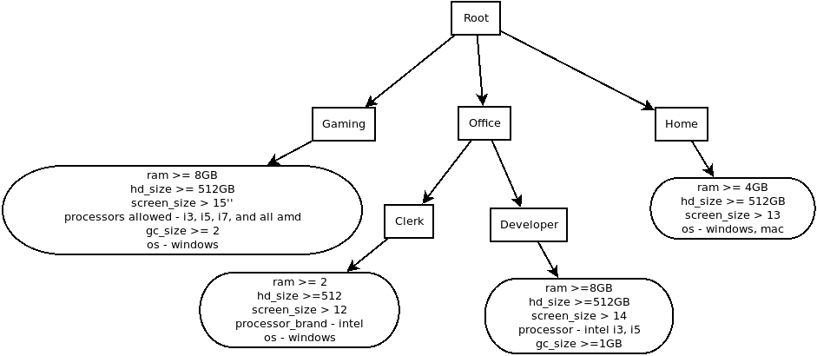
Fig : Classification of Laptops into Categories based on Specification.

Slide 11
Implementation
The whole expert system is made in Prolog.
The console is used to ask questions from the user and a final recommendation is given.
Input:
Type of laptop
Budget Constraint
Steps:
Obtain complete list of laptops in the database.
Filter according to budget constraint.
Sort according to specifications.
Finally, extract the laptops which satisfy user’s type requirement.

Slide 12
How does the Expert System compares Laptops
The expert system uses the comparator rule compare_laptop with arity 2.
This rule compares the laptops on the basis of their price, processor_brand,type of processor , graphic card size and screen size.
If a laptop completely dominates over the other, then it is given a priority. The above rules are prioritized:
Price
Processor brand
Processor Type
Graphic card size
Screen size

Slide 13
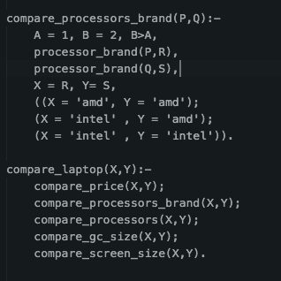

Slide 14
Future Scope

Slide 15
DEMONSTRATION

Slide 16
Thank you!

